Slide 1
MOBILE MANUFACTURER
DATA ANALYSIS
SQL-based analysis of cellphone sales, customers, products and regional demand

Slide 2
Project Overview
This project analyzes cellphone sales and transaction data using MySQL. The database, Cellphones Information, contains data related to manufacturers, cellphone models, customers, locations, and sales transactions.
The analysis focuses on understanding cellphone sales patterns across different states, manufacturers, models, customers, and years.
An interactive dashboard is built to visualize key insights, trends, and operational metrics.

Slide 3
Business Problem
The cellphone sales database contains transaction information across different manufacturers, models, customers, states, ZIP codes, and years. However, the business needs to understand how cellphone sales are distributed across regions, which manufacturers and models perform best, and how customer purchasing behavior changes over time.

Slide 4
OBJECTIVE
Analyze cellphone sales across different states and locations.
Identify the top-performing manufacturers and models based on sales and quantity.
Analyze customer spending and behaviour change across different years.
Compare manufacturer and model performance across 2008, 2009, and 2010.
Identify changes and trends in sales and customer spending over time.
Use SQL queries to extract meaningful insights from the database.

Slide 5
DATASET DESCRIPTION
Dim_manufacturer: Contains manufacturer information ; IdManufacturer and Manufacturer_name. IdManufacturer is the primary key
Dim_model: Contains cellphone model information that is IdModel, Model_name, Unit-price and IdManufacturer. IdModel is the primary key and IdManufacturer is the foreign key.
Dim_customer: Contains customer information; IdCustomer, Customer_name, Email and Phone. IDcustomer is the primary key.
Dim_Location: Contains location-related information; IDLocation, Zipcode, Country, etc. IdLocation is the primary key.
Fact_Transactions: Contains cellphone sales and transaction information like IdModel (foreign key), IdCustomer (foreign key), IdLocation (foreign key), Date, Totalprice and Quantity.
Dim_date: Contains date, year, quarter and month.

Slide 6
BUSINESS QUESTIONS
Q. Which states have customers who purchased cellphones from 2005 onwards?
Q. Which US state has the highest number of Samsung cellphone purchases?
Q. How many transactions were made for each model by ZIP code and state?
Q. Which is the cheapest cellphone and what is its price?
Q. What is the average price of models belonging to the top 5 manufacturers by sales quantity?
Q. Which customers spent more than $500 on average in 2009 and the average amount they spent?
Q. Which models were among the top 5 by quantity in 2008, 2009, and 2010 simultaneously?
Q. Which manufacturer had the second-highest sales in 2009 and 2010?
Q. Which manufacturers sold cellphones in 2010 but not in 2009?
Q. Who are the top 100 customers based on average spending, average quantity purchased and how did their spending change year over year?

Slide 7
PROJECT APPROACH
Understanding Business Problem
Define key business requirements related to sales, products, and customer behavior.
Understanding the Data and Data preparation
Review database tables, relationships, and relevant transaction fields.
SQL Analysis
Use JOINs, Group by, aggregations, subqueries, Intersect, Except and Lag() to answer business questions.
Power BI Dashboard Development
Build interactive visual reports featuring KPI cards, geo map, and dynamic slicers.
Identify Key Findings
Analyze regional demand, product performance, manufacturer trends, and customer spending.
Business Recommendations
Improved regional sales, overall sales, customer retention, and marketing strategies with the help of findings.

Slide 8
KEY FINDINGS
Cellphone purchase was made in all seven states; Arizona, Maryland, Haryana, California, Maharashtra, Delhi and Karnataka since 2005.
Arizona is the only US state where highest number of Samsung cellphones are purchased, indicating strong Samsung demand in the state.
Analyzed the number of transactions by cellphone model, ZIP code, and state. The transaction volumes varied by state and ZIP code, which indicates differences in product demand across regions.
Model- 3210 was identified the cheapest cellphone model and its price is $14 units.
The analysis of the top manufacturers helped compare their sales performance and the average prices of their models.
Identified six high value customers with an average spending of more than $500 in 2009.
Model-109 remained among the top five most purchased models in 2008, 2009, and 2010, indicating consistent customer demand.

Slide 9
KEY FINDINGS
Samsung had the second-highest sales in 2009, while Apple ranked second in 2010, showing a change in manufacturer’s performance.
HTC recorded sales in 2010 but had no record of sales in 2009, indicating a change in it’s sales.
Analyzed the top 100 customers, including their average spending, average quantity purchased, and changes in spending over time to under the customer purchasing behaviour.

Slide 10
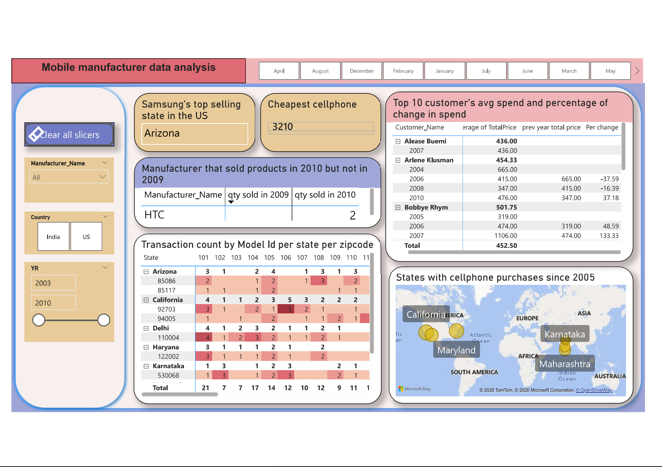
Mobile Manufacturer Analysis Dashboard

Slide 11
BUSINESS INSIGHT
Focus on high-demand products: Models such as Model 109, which showed consistent demand across multiple years, should receive priority in inventory and promotional planning.
Target high-performing regions: Arizona was found the state in US with highest Samsung sales. Company can increase Samsung promotions and inventory in that region to achieve more sales.
Retain high value customers: Business should focus on the high value customers by offering membership to them to reward their purchases. Also high-end products recommendations can be given to these customers.

Slide 12
BUSINESS INSIGHT
Use customer spend for target marketing: By analyzing the year over year change in average spend, company can target different customer segments based on the difference in average spend.
Monitor changes in manufacturer performance: It was identified that Samsung was top 2nd manufacturer in 2009 but in 2010 Apple took over the 2nd position indicating the customer’s preferences were changed. Business should regularly monitor the change to make strategies accordingly.

Slide 13
CONCLUSION
The analysis offers a comprehensive understanding of mobile sales, customer purchasing behaviour, product demand, and regional performance over time. The findings highlight variations in sales across states, manufacturers, and mobile models, as well as consistently popular products and changes in manufacturer performance over time. Customer-level analysis assisted in identifying high-value customers as well as shifts in their spending and purchasing habits. Overall, these insights can help businesses make more informed decisions about product planning, regional sales strategies, customer targeting, and marketing efforts, leading to higher sales performance and customer retention.

